Slide 1
Pollination

Slide 2
Aim
To know that flowering plants reproduce.
Success Criteria
To understand the importance of insects in pollination.
To know that pollen is produced by flowers and is the key to pollination.
To know the roles of parts of the flower in pollination.

Slide 3
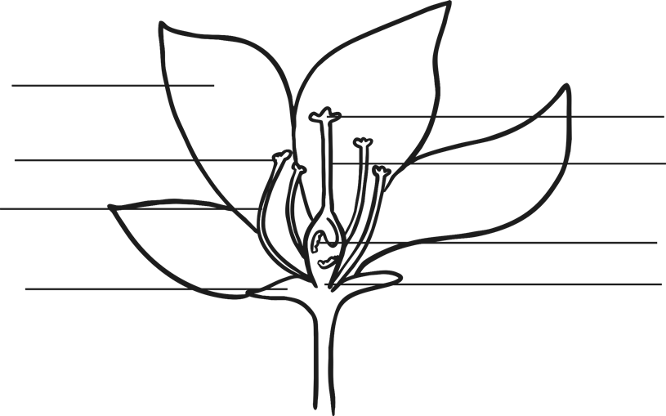
Recap
Nominate some willing volunteers to stick the words in the correct places.
carpel
stamen

Slide 4
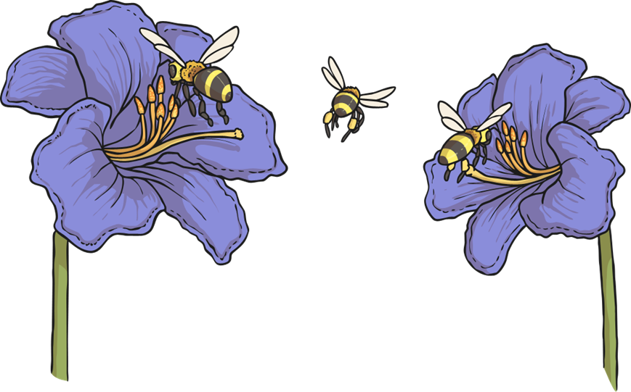
Recap
Plants produce seeds in order to reproduce. To make a seed, a flower must be pollinated.
Pollen is made by the male part of the plant, which is called the stamen. The pollen needs to get to the female part of the plant, which is called the stigma. Most plants cannot pollinate themselves, but a large amount of orchids can. What might be an advantage of self-pollination?
The pollen must then travel from one plant to another plant of the same species (e.g. from a rose to a rose or from a daffodil to a daffodil). This is called cross-pollination.

Slide 5
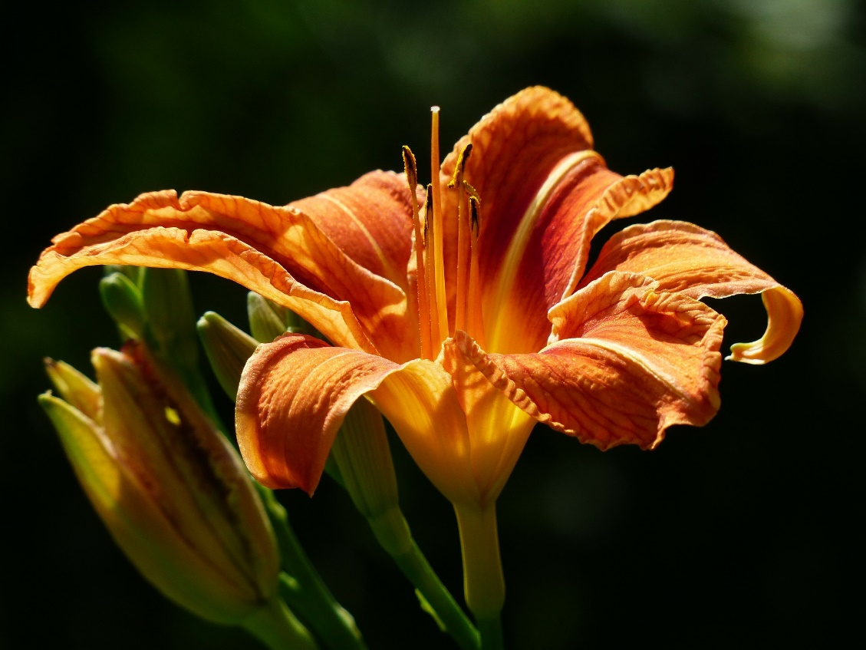
The Vital Roles in Pollination
Just like actors in a play, each part of the flower has a role to play. These parts are vital and pollination wouldn’t be able to take place without any one of these.

Slide 6

Petal
It is the petal’s job to attract the insects towards the flower.
Interestingly, the colours that we see are not the same as the colours that the insects see. Insects see in ultraviolet, which is a type of light which is outside the range of what human eyes can see.
petal

Slide 7
Style
The style is above the ovary and its job is to hold up the stigma. The style, ovary and stigma all make up the female part of the flower, which is called the 'carpel' or 'pistil'.
style

Slide 8
Stigma
stigma
The stigma’s job is to collect the pollen from other plants when insects brush by it. It has adapted to catch the pollen in different ways, e.g. some stigma have tiny hairs on them to collect the pollen. It is on the stigma that the growing process first begins.

Slide 9
Filament
The filament’s role is to hold up the anther. If the anther was very low down, then insects might not be able to collect that flower’s pollen. What would happen if pollen was harder for insects to collect?
filament

Slide 10
Anther
anther
The role of the anther is to produce the pollen. It is important that this pollen is then carried to another plant.
Which part of the plant would the pollen need to be taken to?

Slide 11
Ovary
It is the ovary's job to hold the ovules and to keep them safe until the flower gets pollinated.
ovary

Slide 12
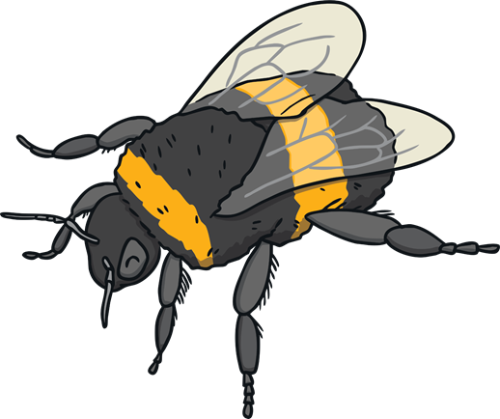
Insects in Pollination
Insects don't pollinate on purpose, it's just something that happens as they collect nectar from flowers to feed on. Insects are incredibly important when it comes to pollination. Here are some facts to prove it:
84% of crops in Europe are pollinated by insects. This is worth £12.6 billion a year.
Honey bees account for 80% of all insect pollination.
Nearly all chocolate relies on midges pollinating the cocoa plant, which might make them seem slightly less annoying!

Slide 13
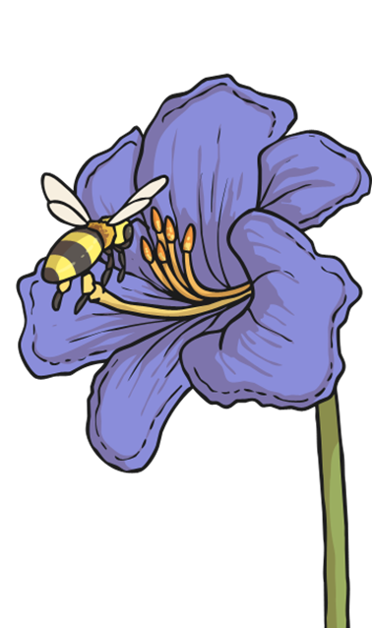
The Pollination Process
The flower petal’s bright colours and fragrant scents attract insects.
The insect arrives on the flower to collect nectar. This nectar is a sweet liquid which makes perfect insect food.
As the insect is gathering the nectar, it rubs against the anthers, which rub pollen onto the insect.
After the insect is done feeding on the flower’s nectar, it gets hungry and gets attracted by another flower`s bright colours.

Slide 14
The Pollination Process
As the insect feeds on the nectar in this new flower, the pollen stuck to the insect from the first flower, rubs off onto the female parts of the second flower (the stigma).
Part of this pollen travels down the style and then into the ovary.
The tiny piece of pollen joins onto an ovule in the ovary. The plant has now been fertilised.
The ovary of the flower turns into seeds, which will then be dispersed so that new plants will be able to grow somewhere else.

Slide 15
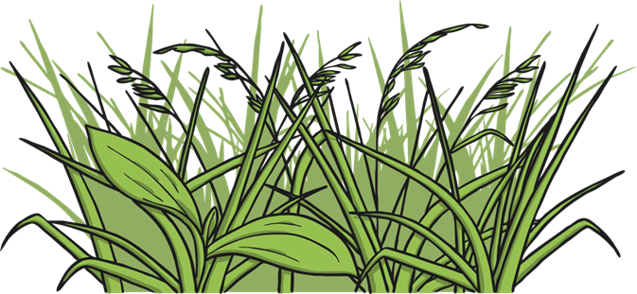
Wind Pollination
While some plants use insects to help them transport their pollen, others rely on wind. These plants are usually less colourful as they do not need to attract insects. The wind carries pollen from one plant to another. Rice is an example of a wind-pollinating plant.
This is a less coordinated way of pollinating, as it relies on a huge amounts of pollen being blown in any direction, depending on the wind.
Wind pollinating plants can cause some people to experience hay fever during the spring and summer due to the large amounts of pollen in the air.

Slide 16
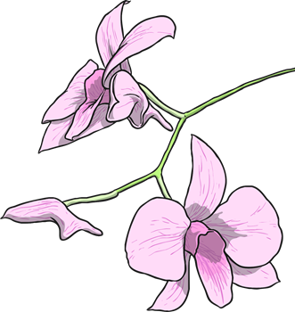
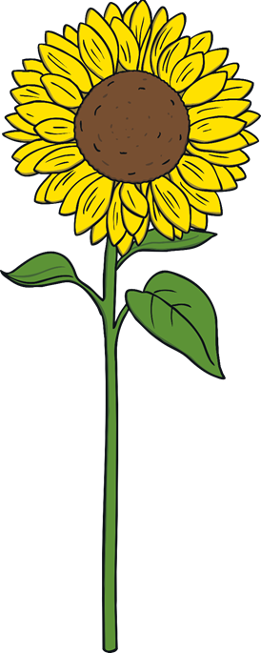
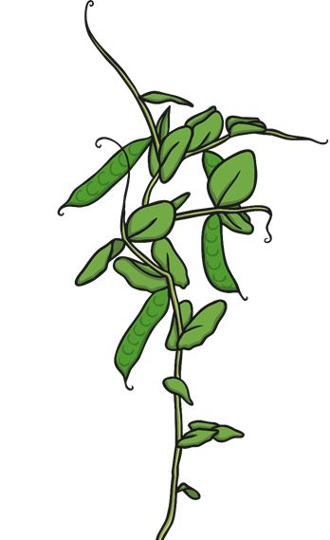
Self-Pollination
Some plants self-pollinate. They transfer the pollen grains from the anther to the stigma on the same flower. These plants do not need a pollinator, such as an insect, in order to reproduce.
Only a few plants self-pollinate. Examples include peanuts, orchids, peas and sunflowers.

Slide 17
Pollination in Action (Optional Activity)
We are going to do an activity to show how pollination works.
On your tables you have a paper bag with a large picture of a flower on the front with cheese puffs inside.
After you’ve washed your hands thoroughly, go and collect some cheese puffs from the bag on another table (make sure you save some for everyone else). After you’ve eaten them, don’t wipe your hands or lick your fingers, tempting though it may be!
Go to a bag on another table and wipe your hands on the pretty flower on the front of the bag.
Those yellowy smears left behind represent pollination!

Slide 18
Pollination Facts
1. is produced by flowers and can be collected by insects.
2. The job of the stigma is to .
3. The job of the filament is to .
4. The job of the style is to .
5. The job of the anther is to .
6. The job of the ovary is to .
7. Lastly, what percentage of Europe’s crops are pollinated by insects?

Slide 19
Pollination Facts Answers
1. Nectar/pollen is produced by flowers and can be collected by insects.
2. The job of the stigma is to collect the pollen from other plants when insects brush by it.
3. The job of the filament is to hold up the anther.
4. The job of the style is to hold up the stigma.
5. The job of the anther is to produce the pollen.
6. The job of the ovary is to hold the ovules and to keep them safe until the flower gets pollinated. 7. 84%.

